Slide 1

DATABASE AND SQL COMMANDS

Slide 2
Agenda
DATABASE
FILE MANAGEMENT SYSTEM
SQL COMMANDS

Slide 3
An organized collection of structured information, or data stored in a computer system . And usually controlled by database management system. Structured query language (sql) is commonly used for data querying and writing. Can organize data into structures such as tables or collections Can operate a large amount of information by storing, retrieving, and managing data.
DATABASE
WHAT IS DATA???
a piece of information that can be translated into a form for efficient movement and processing is called data. A database is a collection of data that is organized.

Slide 4
Concept of Database
To store and manage data efficiently in the database let us understand some key terms:
Database Schema:
It is a design of the database. Or we can say that it is a skeleton of the database that is used to represent the structure, types of data will be stored in the rows and columns, constraints, relationships between the tables.
2. Data Constraints:
In a database, sometimes we put some restrictions on the table that what type of data can be stored in one or more columns of the table. Constraints are defined while we are creating a table.
3. Data dictionary or Metadata:
Metadata is known as the data about the data. Or we can say that the database schema along with different types of constraints on the data is stored by DBMS in the dictionary is known as metadata.
4. Database instance:
a database instance is used to define the complete database environment and its components.
5. Query:
In a database, a query is used to access data from the database.
6. Data manipulation:
In a database, we can easily manipulate data using the three main operations that is Insertion, Deletion, and updation.
7. Data Engine:
It is an underlying component that is used to create and manage various database queries.

Slide 5
FILE MANAGEMENT SYSTEM
A File Management System (FMS) is a Database Management System that allows access to single files or tables at a time.
FMS’s accommodate flat files that have no relation to other files
Arranges files within a storage medium
Less complex than DBMS.
Less secure.
No data independence.
Provides basic operations (create, delete, rename, access)

Slide 6
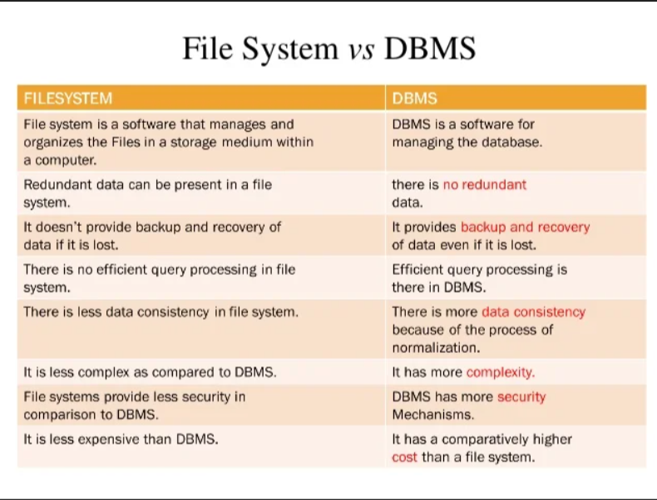

Slide 7
WHAT IS SQL AND SQL COMMANDS

Slide 8
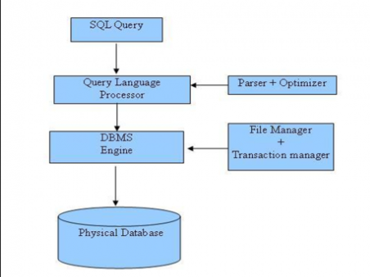
What is SQL??
SQL stand for structured query language.it is used for storing and managing data in RDBMS
It is a standard language for relational database and tables
WHY SQL
SQL can execute queries against a database.
SQL can retrieve data from a database
SQL can insert, update, delete, records from a table
SQL can create views in tables
Its is mainly represent in tables

Slide 9
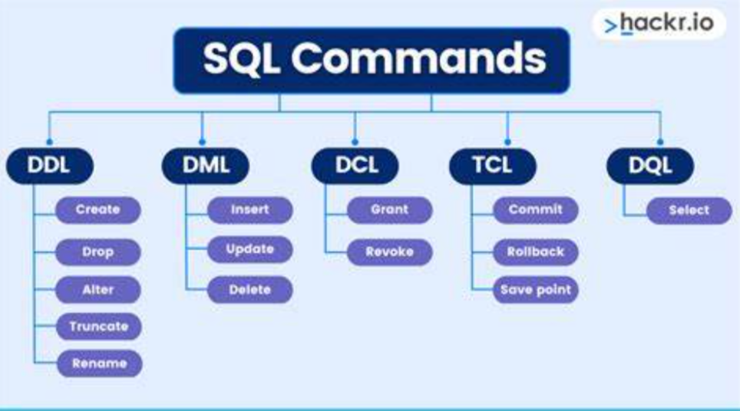

Slide 10

DDL COMMAND
DDL is a set of SQL commands used to create, modify, and delete database structures but not data.
Data definition language
It can be used to define database schema.
used to create and modify the structure of database objects in the database.

Slide 11
CREATE:
This command is used to create a new database, table, index, or other database object.
CREATE DATABASE database_name; CREATE TABLE table_name (column_1 datatype, column_2 datatype, ...);
CREATE INDEX index_name ON table_name (column_1, column_2, ...);
DROP:
This command is used to delete an existing database, table, index, or other database object.
DROP DATABASE database_name; DROP TABLE table_name; DROP INDEX index_name ON table_name;
ALTER:
This command is used to add, delete, or modify columns or constraints in an existing table.
ALTER TABLE table_name ADD column_name datatype; ALTER TABLE table_name DROP column_name;
ALTER TABLE table_name MODIFY column_name datatype;
TRUNCATE:
This command is used to remove all rows from a table, but the structure of the table remains intact.
TRUNCATE TABLE table_name;
RENAME:
This command is used to change the name of a table or other database object.
RENAME TABLE old_table_name TO new_table_name;

Slide 12
DmL COMMAND
The DML commands in Structured Query Language change the data present in the SQL database.
Data Manipulation Language
We can easily access, store, modify, update and delete the existing records from the database using DML commands.

Slide 13
Select :
SELECT column_Name_1, column_Name_2, ….., column_Name_N FROM Name_of_table;
SELECT * FROM table_name;
Insert:
INSERT INTO TABLE_NAME ( column_Name1 , column_Name2 , column_Name3 , .... column_NameN ) VALUES (value_1, value_2, value_3);
Update:
UPDATE Table_name SET [column_name1= value_1, ….., column_nameN = value_N] WHERE CONDITION
Delete:
DELETE FROM Table_Name WHERE condition;

Slide 14
DcL COMMAND
DCL is an abbreviation for Data Control Language
It is used to provide different users access to the stored data.
It enables the data administrator to grant or revoke the required access to act as the database.

Slide 15
Grant:
GRANT SELECT ON student TO Aman;
Revoke:
REVOKE SELECT ON student FROM Aman;

Slide 16
SQL Constraints

Slide 17
Constraints are the rules that we can apply on the type of data in a table. That is, we can specify the limit on the type of data that can be stored in a particular column in a table using constraints.
The available constraints in SQL are:
NOT NULL: we cannot store a null value in a column.
UNIQUE: all the values in the column must be unique. That is, the values in any row of a column must not be repeated.
PRIMARY KEY: A primary key is a field which can uniquely identify each row in a table.
FOREIGN KEY: A Foreign key is a field which can uniquely identify each row in a another table.
CHECK: This constraint helps to validate the values of a column to meet a particular condition.
DEFAULT: This constraint specifies a default value for the column when no value is specified by the user.

Slide 18
ACID PROPERTIES
In the context of Database Management Systems (DBMS), ACID properties refer to a set of four key properties that ensure reliable processing of database transactions. ACID stands for Atomicity, Consistency, Isolation, and Durability. These properties are crucial for maintaining the integrity and reliability of a database.

Slide 19
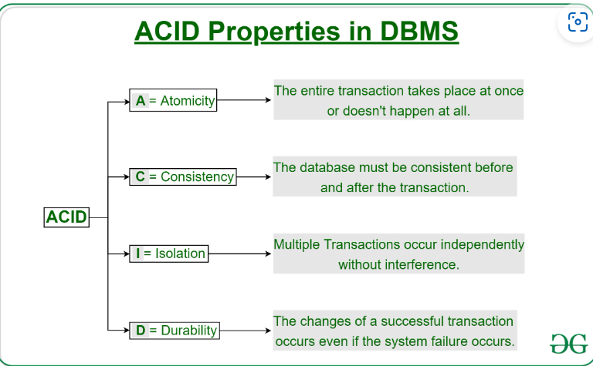

Slide 20


Thank you…

